Slide 1
DATA10: Anatomy of a Deal: Superdome Flex in FSI CyberSecurity Applications

Slide 2
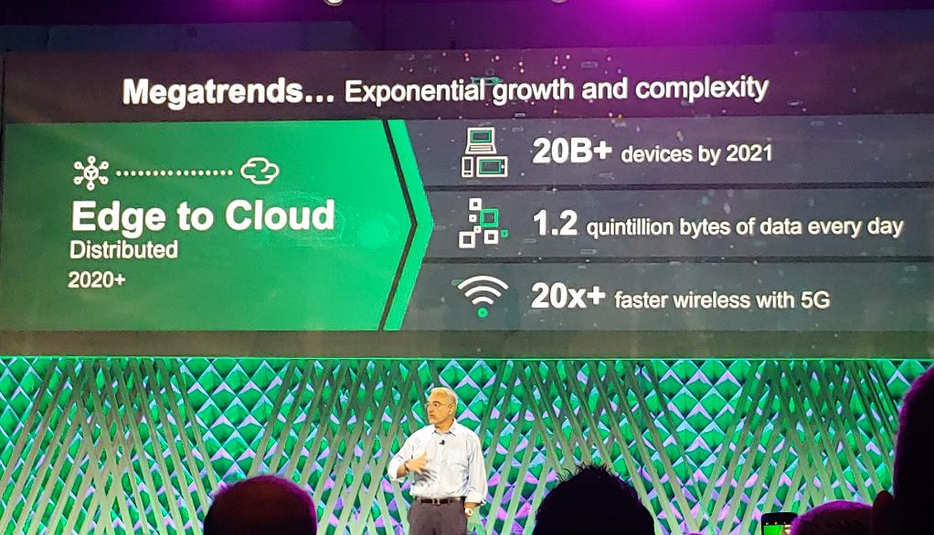
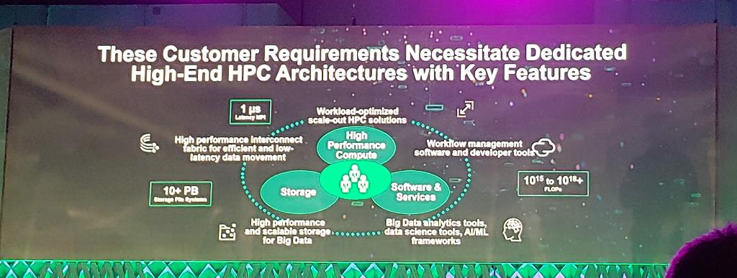
Don’t Take My Word For It…

Slide 3



What’s driving the data explosion?
Structured data
40 petabytes
Walmart’s transaction database (2017)
Human interaction data
4 petabytes a day
Per-day posting to Facebook across 2 billion users (2017)
2MB per active user
Digitization of analog reality
40,000 petabytes a day*
10m connected cars by 2020
Front camera 20MB / sec
Front ultrasonic sensors 10kB / sec
Infrared camera 20MB / sec
Front radar sensors 100kB / sec
Side ultrasonic sensors 100kB / sec
Front, rear and top-view cameras 40MB / sec
Crash sensors 100kB / sec
Rear ultrasonic cameras 100kB / sec
Rear radar sensors 100kB / sec
* Driver assistance systems only
Notes:
This slide shows examples of how not just he amount of data is changing, but that we have new sources, new things we need to do with that data and less and less time to do those things.
Once social media had taken off, we started to talk about the vast amounts of data that was being processed. It was way more than the structured data we’d processed up to that point.
For example, by May 2016, Facebook was processing 4 petabytes of data a day. That’s twice the entire Walmart transaction (structured) database, every day. While this is high, it’s actually only 2MB per active Facebook user.
However, we’re about to take another leap in magnitude in the amount of data we’ll be processing. For example, just one self-driving car will generate 4 terabytes of data a day (as the graphic on the right nicely shows). That’s just one car. There will be 10 million of them by 2020. And that’s just self-driving cars. We’ll be generating such levels of data from IoT sensors all over our “physical world”.
Why do much data? Because we are moving to an era where we sense reality. And, unlike structured data and social media data, reality is not digital. We need to create a digital version of our analog reality. That takes a lot of data (actually, the amount of data it generates is our choice – the higher the fidelity of our sensors the more data we generate. And our analysis is better if we have high fidelity sensors – so we will have a lot of data).
Walmart and Facebook in their own ways, are extracting huge value and monetizing their 2-4PB of data, (maybe even still scratching the surface) When someone figures out how to extract value from that 40kPB and the things they will be able to do, will seem like magic. To extract value – we need new architectures/techs to achieve that. Memory driven architectures, AI/ML, etc.
*This 40EB per day figure is for the driver assistance/autonomous driving sensory systems Most modern vehicles today already have more than 100 microprocessors handing the vehicle operational technology and all of that data is also thrown away save the check engine light codes.
Note: HPE’s working set is 19PB across 8,000 databases
[next: more on the data explosion and the compute gap]
Sources :
Walmart’s transaction database of 40 petabytes - Forbes article, Jan. 23, 2017 https://www.forbes.com/sites/bernardmarr/2017/01/23/really-big-data-at-walmart-real-time-insights-from-their-40-petabyte-data-cloud/#524df6af6c10
Facebook: Brandwatch, Mar. 5, 2018 https://www.brandwatch.com/blog/47-facebook-statistics/
Number of self-driving cars : Business Insider, June 2016 https://www.businessinsider.com/report-10-million-self-driving-cars-will-be-on-the-road-by-2020-2015-5-6
Car stats : Intel newsroom https://newsroom.intel.com/editorials/krzanich-the-future-of-automated-driving/

Slide 4
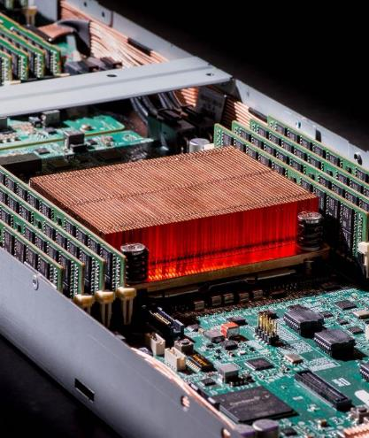
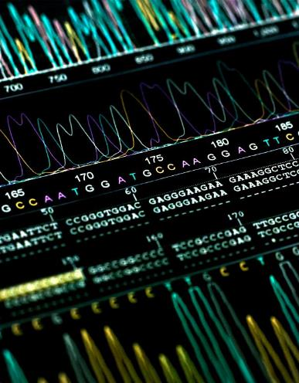
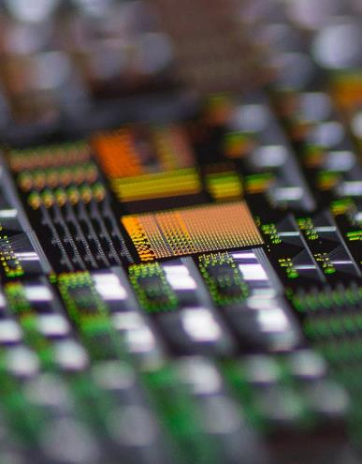
We are radically rethinking our approach to computing
Advancing computing without relying on Moore’s Law
Unconventional
architectures
Unconventional programming
Unconventional
accelerators
Notes:
The Memory-Driven Computing architecture invites diversity – of components, of companies, of approaches. We’re bypassing the limitations of Moore’s law with Memory-Driven Computing.
We now have line of sight to tremendous performance improvements without relying on an antiquated set of compromises and inefficiencies.
We’re building and programming computers to work smarter, not just harder.
Unconventional architecture
This refers to the Memory-Driven Computing architecture itself. We’re not reinventing every component in a computer, but we’re connecting them up in a different way. A way that removes bottlenecks, outdated interfaces and unnecessary layers of memory and storage.
An unconventional architecture like Memory-Driven Computing also provides a framework to access accelerators at the speed of memory rather than relegating them to the thousand-time-slower I/O regime.
Unconventional programming
As you’ll see on the next two slides, by thinking differently about programming we’ve demonstrated up to 10,000x faster execution on real-world workloads running on HPE big-memory systems. The key tenet is to buy speed with abundant memory. To stop calculating the same over and over again, but to store the results and simply look them up the next time the same data is required.
Unconventional accelerators
Here don’t just throw away the programming manual and architecture rulebook, we’re tossing out the transistor too. We can build nanoscale analog and optical engines to do instantly what conventional accelerators execute hundreds of thousands of lines of code to do.
We can also harness “Standard” accelerators (GPU, DSP, TPU, FPGA), which are still built using conventional transistors. While more efficient than general-purpose processors, these technologies are still constrained by Moore’s Law. They are also hamstrung, as mentioned above, because they have been relegated to the I/O regime and the three orders of magnitude greater latency. Memory-Driven Computing sets standard accelerators free, allowing them to will plug into HPE’s unconventional architecture at memory speed.
And all of this is open. Our programming tools are open source, the Gen-Z fabric is open to consortium members (anyone can join). And anyone can make accelerators that will plug right in.
[Next: Memory-Driven Computing fundamentals]

Slide 5
Today’s architecture
From processor-centric computing
Future architecture
Memory-Driven Computing
Memory
Memory
Memory
SoC
GPU
SoC
SoC
FPGA
DSP
Memory
Memory
SoC
SoC
ARM
x86
Memory
Memory
SoC
SoC
Memory
RISC V
ASIC
SoC
SoC
SPARC
Photonic
Memory
Memory
SoC
SoC
POWER
Neuro
SoC
Quantum
Memory
Memory
Memory
Notes:
[This is why Memory-Driven Computing is “Powerful” (addressing the first pillar). Note, this slide contains the single most important concept in the Memory-Driven Computing architecture.]
The challenges are always on building enough memory to keep up with compute. Memory has always been the scarce resource (never enough volume/resources).
Traditional computers chop up your information – the data – to match the limitations of the processor
Processor as gatekeeper
We flip that around and puts the data first – bringing processing to the data
Processor almost irrelevant – can swap out to suit task
We call this Memory-Driven Computing
SoC, universal memory and photonics are the key parts of the architecture of the future
With this architecture, we can ingest, store and manipulate truly massive datasets while simultaneously achieving multiple orders of magnitude less energy/bit
Q: What is HPE doing here that is truly different?
A: New technologies are not substitutional - we’re re-architecting
[Next: Memory-Driven Computing concept build out…]

Slide 6

Traditional vs. Memory-Driven Computing architecture
Flash
PCM
ARM CPU
GPU
CPU
GPU
Quantum
X86 CPU
FPGA
DRAM
Neuro
Flash
ReRAM
SCM
RISC-V
CPU
Optical
Notes:
Today, the CPU vendor defines the architecture. New technologies can only be introduced with a CPU update. And if you want to connect more of something than the CPU has lanes for, you have to get a second CPU and deal with complex, slow communication between them.
Memory-Driven Computing breaks those constraints. Any combination of components can be connected together at will, over an ultra-fast web of interconnects (called a “fabric”) and communicate using simple, efficient commands. At the speed of memory communications today, hence the name: Memory-Driven Computing.
Memory-Driven Computing breaks the innovation constraint, too. Anyone can innovate and immediately connect new technology as it becomes available.
Note that HPE is doing something truly different here. We’re not just making incremental improvements within the same old architecture. We’re re-architecting.
[Next: more on the components and composability.]

Slide 7
Memory-Driven Computing is the future for every kind of computing
Cloud infrastructure
Big memory machine
Exascale computer
Edge device
Notes:
Memory-Driven Computing is a universal, open architecture that can mix and match – compose and recompose – resources to address any computing task in any location from every edge to any cloud.
Imagine an edge device like a smart video camera. You could combine a neural net accelerator with non-volatile memory to create an ultra-low power vision system capable of understanding its environment.
Memory-Driven Computing can be used to replace today’s large hyperscale deployments with much greater responsiveness and power-efficiency. Microservices, containers and virtual machines can be spun up and down in microseconds at massive scale.
You can build big-memory machines capable of holding any data set at once. When you stop chopping up data sets to mask the limitations of today’s CPU-centric architecture, massive speed gains can be achieved. More on that in a couple of slides’ time.
And at the highest end, we’re using Memory-Driven Computing principles to build exascale computers. At a billion-billion calculations per second, exascale computing will transform our ability to solve some of mankind’s most complex problems, arriving at solutions never before thought possible. But we will need computers with vastly greater sophistication and power efficiency than can be constructed today. Memory-Driven Computing principles allows us to compose diverse computing elements to build high-end systems to solve previously impossible enterprise problems at any scale. And these advantages trickle down to smaller, enterprise HPC systems.
[Next: how big can Memory-Driven Computing go?]

Slide 8
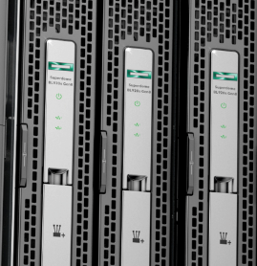
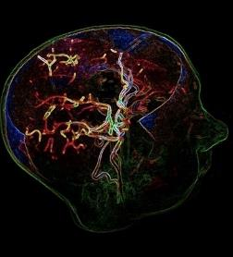
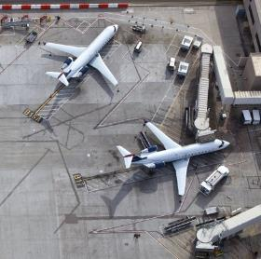



Memory-Driven Computing has the power to transform industries
Modify existing frameworks
New algorithms
Completely rethink
In-memory analytics
Genome
comparison
Large-scale graph inference
Financial models
15x faster
100x faster
1000x faster
10,000x faster
Notes:
This is what you can achieve if you throw away 60 years of software assumptions and legacy.
Spark is one of the leading open source tools to do in-memory analytics on a cluster of servers.
As part of another project, we wanted to see what we could do with Spark if we adapted to a large memory system. The results were astounding.
15X s compared to “vanilla” Spark. We can also run 20x bigger data sets that won’t run all at all normally. All from rewriting a couple of hundred lines of code.
[harnesses the “well-connected” vector. Not big memory, just many processing elements on the pool of memory]
[The other three harnesses abundance: need all the memory the same “distance” away]
As world populations age, the human and economic toll of currently incurable neurodegenerative diseases such as Alzheimer’s grows staggering. DZNE fights these diseases using Big Data analytics, but the limitations of traditional computer systems have been a major bottleneck. Seeking a breakthrough solution, DZNE discovered HPE’s Memory-Driven Computing—and saw unprecedented computational speed improvements that hold new promise in the race against Alzheimer’s.
Using Memory-Driven Computing programming techniques on an HPE Superdome X system, DZNE has seen a 22 minute process drop to 13 seconds. That’s more than a 100x speed improvement
Graphs increasingly represent our connected world today. Graph inference is how you make predictions using a small known set of data.
Comparison is with GraphLab, the state-of-the-art today.
Financial modelling is Monte Carlo simulations used to predict things like derivatives pricing and portfolio risk management.
Comparison is with open source QuantLib package.
If you plan sharing the Memory-Driving Computing SW proof point section, you can talk more about how we’ve come up with these numbers.

Slide 9
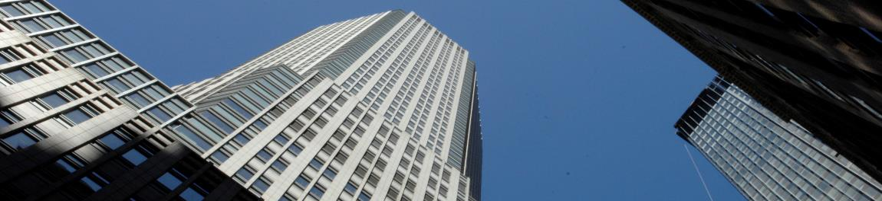
Financial Services Customer
Presence in over 100 markets
Millions of customers
Assets exceeding $2T
Diversified portfolio
Notes:
One of the oldest financial institutions in the United States. With a history dating back over 200 years, here's where we stand today:
We are a leading global financial services firm with assets of $2.6 trillion.
We have a presence in over 100 markets.
We have over 250,000 employees.
We serve millions of consumers, small businesses and many of the world's most prominent corporate, institutional and government clients.
We are a leader in investment banking, financial services for consumers and small businesses, commercial banking, financial transaction processing and asset management.

Slide 10

One of the largest Cybersecurity Attack Surfaces in the World
100’s of Thousands
Attacks per day
Hours
Current scan time
Weeks to Month
Time to determine threats

Slide 11
Financial Services Customer Areas of Interest
Investment Banking / Trading
Credit Card / Consumer Banking
Branch Surveillance
Data repositories
Notes:
Investment Banking / Trading ( Real-time Event correlation )
Credit Card & Consumer banking ( Fraud detection )
Branch Surveillance ( Facial, Object, Queue )
Hadoop service platform

Slide 12

Limited by Today’s Technologies
4 hours 14 minutes
Vulnerability Detection scan
5 hours
Vulnerability Assessment scan
Not possible
Real-time Zero Day scan

Slide 13

Goal
Faster identification of threats (known and unknown) to reduce / eliminate data exfiltration

Slide 14
Memory-Driven Computing has the power to transform industries
Modify existing frameworks
New algorithms
Completely rethink
In-memory analytics
Genome
comparison
Large-scale graph inference
Financial models
15x faster
100x faster
1000x faster
10,000x faster
Notes:
This is what you can achieve if you throw away 60 years of software assumptions and legacy.
Spark is one of the leading open source tools to do in-memory analytics on a cluster of servers.
As part of another project, we wanted to see what we could do with Spark if we adapted to a large memory system. The results were astounding.
15X s compared to “vanilla” Spark. We can also run 20x bigger data sets that won’t run all at all normally. All from rewriting a couple of hundred lines of code.
[harnesses the “well-connected” vector. Not big memory, just many processing elements on the pool of memory]
[The other three harnesses abundance: need all the memory the same “distance” away]
As world populations age, the human and economic toll of currently incurable neurodegenerative diseases such as Alzheimer’s grows staggering. DZNE fights these diseases using Big Data analytics, but the limitations of traditional computer systems have been a major bottleneck. Seeking a breakthrough solution, DZNE discovered HPE’s Memory-Driven Computing—and saw unprecedented computational speed improvements that hold new promise in the race against Alzheimer’s.
Using Memory-Driven Computing programming techniques on an HPE Superdome X system, DZNE has seen a 22 minute process drop to 13 seconds. That’s more than a 100x speed improvement
Graphs increasingly represent our connected world today. Graph inference is how you make predictions using a small known set of data.
Comparison is with GraphLab, the state-of-the-art today.
Financial modelling is Monte Carlo simulations used to predict things like derivatives pricing and portfolio risk management.
Comparison is with open source QuantLib package.
If you plan sharing the Memory-Driving Computing SW proof point section, you can talk more about how we’ve come up with these numbers.

Slide 15
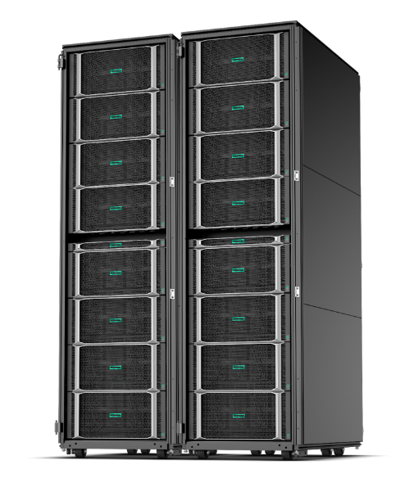
HPE Superdome Flex
The undisputed leader in in-memory computing
Turn data into actionable insights in real time
Unparalleled scale 4-32 sockets, 768GB-48TB+ memory
Ultra-fast fabric
Keep pace with evolving business demands
Unique modular 4-socket building block
Open management and hard partitioning for hybrid IT consumption
Safeguard mission-critical workloads
Proven Superdome RAS with 99.999% single system availability
Mission critical expertise with HPE Pointnext services
Pushing the limits
Software-Defined Scalable Memory project in development to extend to 96TB of composable memory across multiple racks
Designed with Memory-Driven Computing principles
Notes:
Turn data into actionable insights in real time
In-memory design
Unparalleled scale 4-32 sockets and 768GB-48TB memory capacity
Ultra-fast fabric with low latency, high bandwidth technology
Keep pace with evolving business demands
Unique modular building block design, brings incredible flexibility
Up to eight 4-socket modular building blocks
Open management, open APIs with Redfish ecosystem, OneView
Hard partition support
Safeguard mission critical workloads
Proven, unique Superdome RAS
Error Analysis Engine> Best-in-class predictive fault handling Error Analysis Engine, predicts hardware faults and initiates self-repair without operator assistance
“Firmware First” approach, ensures error containment at the firmware level, including memory errors, before any interruption can occur at the OS layer
Some unique HPE Superdome Flex RAS features not present on other x86 servers include: Advanced processor error handling (eMCA Gen2), Advanced memory resiliency (ADDDC +1), Enhanced fabric resiliency (hot cable swap) , Advanced PCIe error recovery (LER)
(Availability based on Hewlett Packard Labs availability analysis and actual measured results. )
Designed with Memory Driven Computing principles: HPE Superdome Flex is a prime example of how HPE is incorporating Memory-Driven Computing design principles and learnings into our new-generation products. With memory abundance, resource pooling, and fast, low-latency fabric, Superdome Flex helps enterprises and HPC environments of any size move at the speed of memory. Some other aspects it shares with Memory-Driven Computing include fabric security and system modularity.
Pushing the limits
And now, thanks to ongoing collaboration between Hewlett Packard Labs and our product teams, Software-Defined Scalable Memory is helping push that to 96 TB and beyond, with faster and more resilient performance. SDSF enables not just greater scale, but also, for the first time, composable memory. It includes new software and firmware advances that enable Superdome Flex’s industry-leading memory fabric to address significantly larger pools of shared memory than previously possible, while also providing the ability to compose resources on the memory fabric for increased resilience and performance.
This research isn’t ready for production, yet, but it shows how we’re using Superdome Flex as a platform to move us forward towards Memory-Driven Computing.
[Next: Pointnext Memory-Driven Computing capabilities.]

Slide 16


Using Graph Analytics to Detect Cyber Security Threats
Vulnerability Detection
The Known
Vulnerability Assessment
The Unknown

Slide 17


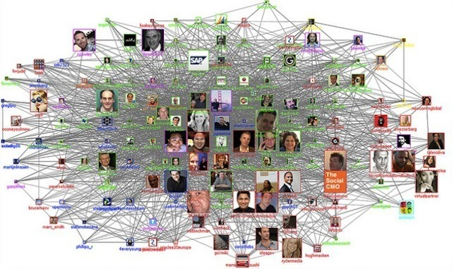


Trovares Software xGT SMP-Optimized Graph Search Engine
Cybersecurity
Fraud detection
Machine Learning
Medical Research
Notes:
Trovares makes a property graph search tool.
A graph search engine
Optimized for SMP, using Intel Threaded Building Block parallelism library
Search is used to find patterns
Useful in cyber, fraud, medical research, machine learning (we think) and other applications with big data
Trovares xGT offers:
Performance
Scalability
Analyst productivity
Forensic Cyber Security
Search all 90-days of the LANL Unified Host and Network Data Set
20 billion graph edges
17.9 billion Netflow
1.5 billion log events
212 billion edge properties
197 billion properties on the Netflow edges
14.8 billion properties on the single-vertex log events
3.2 TB of RAM to hold graph
Further work: Demonstrate graph search at scale on a trillion edge graph

Slide 18
Trovares xGT Scaling
Targeted threats : Zombie Reboot, RDP Hacking
Proved scalability improvements consistently in the 70% to 90% range
As tested : Search 90-days of Netflow and Log events
20 billion graph edges
212 billion edge properties
3.2TB of RAM to hold graph
Near-linear scalability
1000x improvement
Preliminary Results –HPE Confidential - NDA Required

Slide 19

Graph Analytics: Working with Reservoir Labs using Ensign
Core analytics based on “tensor decompositions”
Computationally expensive and sophisticated mathematical methods
Sparse irregular computations add complexity to performance scaling
Unsupervised machine learning
Patented and patent-pending techniques for computation and communication optimizations
Successful application areas
Cyber security
Activity-based intelligence

Slide 20
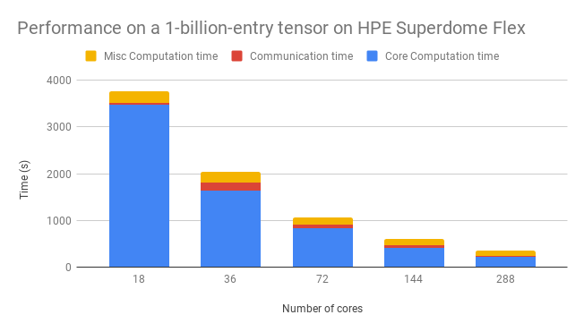
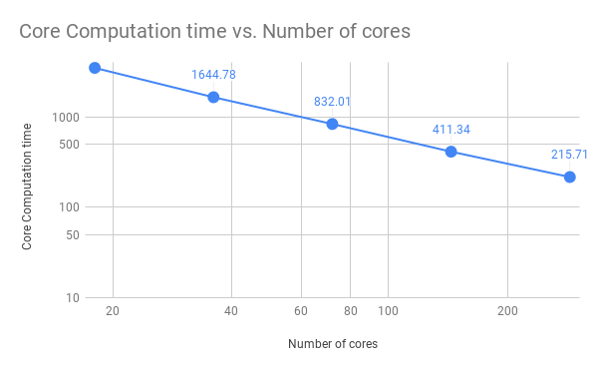
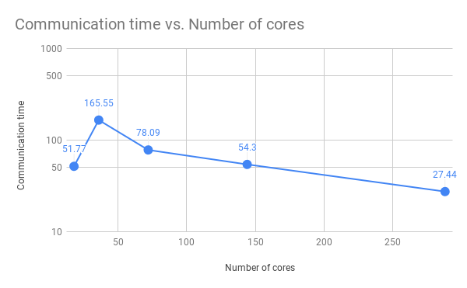
Scaled-up results with HPE SDFX 16-skt 6154 18 core processors
10x improvement
Preliminary Results – HPE Confidential - NDA Required

Slide 21
Limited by Today’s Technologies
4 hours 14 minutes
Vulnerability Detection scan
5 hours
Vulnerability Assessment scan
Not possible
Real-time Zero Day scan

Slide 22
Memory-Driven Computing is Redefining What’s Possible
14.8 seconds
1000x improvement on
Vulnerability Detection scan
20 minutes
>10x improvement on initial
(minimally tuned) Vulnerability
Assessment scan
TBD
Real-time Zero Day scan
Notes:
Vulnerability scan improved from 5 hours to 1 hour running on Superdome Flex, unmodified and untuned. With minimal Linux kernel tuning, the results further improved from 1 hour to 20 minutes (still with no application tuning to leverage the scale-up memory space).

Slide 23

Next: Zero Day scanning
Notes:
Goal, through machine learning model development and training, is to be able to effectively implement zero day attack scanning

Slide 24
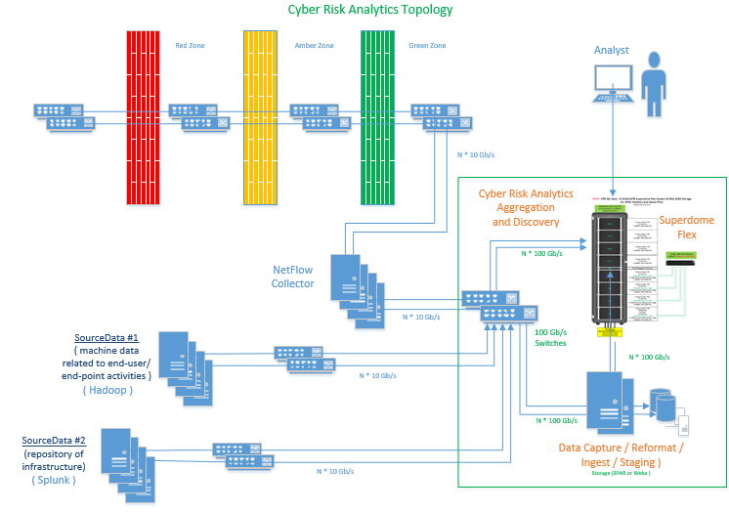
Target State RoM Suggestion ( 1 per DC site, 2 per Geo )

Slide 25
Target State RoM Suggestion ( 1 per DC site, 2 per Geo )
What do we know
Current Rough Architectural view
A few suggested sizes and approaches
A few data points to work off
SDF capabilities
NICs capabilities N*100 Gb/s
2018 use case / read 24 TB in 12 mins (easy)*
Storage ( read > 30 GB/s*/MCC990 )
2013 use case / read 24 TB in 13 mins **
Today Skylake, soon Cascade Lake
Today 8 node, 32 Socket
Today 48 TB Memory
Futures ( NDA )
2020 16 node, 64 Socket
2020 96 TB Memory
Today ( feasibility testing – 3 to 8 weeks )
Proven scalability ( 10x, 100x, 1000x )
Proven time to solution ( Mons to Secs )
Proven Portability ( x86/MC990/SDF )
Proven Lib Migration Centos / Redhat
Further optimizations ( LinuxKI ) ***
Sizing based on Actual reqs.

Slide 26
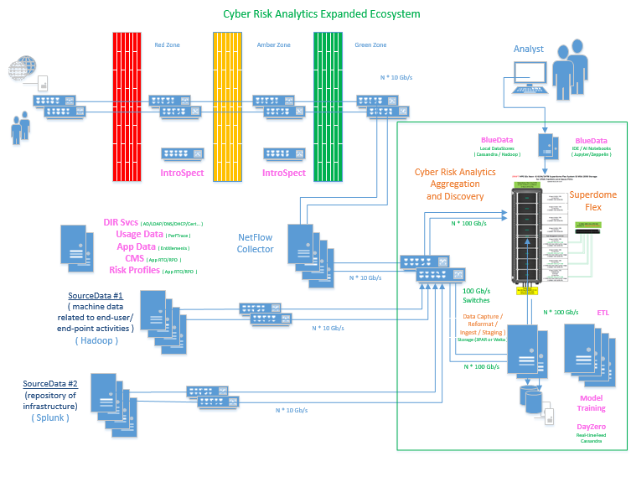
Next Steps

Slide 27
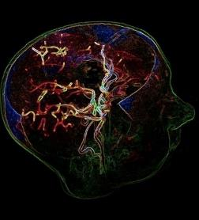
Memory-Driven Computing has the power to transform industries
Modify existing frameworks
New algorithms
Completely rethink
In-memory analytics
Genome
comparison
Large-scale graph inference
Financial models
15x faster
100x faster
1000x faster
10,000x faster
Notes:
This is what you can achieve if you throw away 60 years of software assumptions and legacy.
Spark is one of the leading open source tools to do in-memory analytics on a cluster of servers.
As part of another project, we wanted to see what we could do with Spark if we adapted to a large memory system. The results were astounding.
15X s compared to “vanilla” Spark. We can also run 20x bigger data sets that won’t run all at all normally. All from rewriting a couple of hundred lines of code.
[harnesses the “well-connected” vector. Not big memory, just many processing elements on the pool of memory]
[The other three harnesses abundance: need all the memory the same “distance” away]
As world populations age, the human and economic toll of currently incurable neurodegenerative diseases such as Alzheimer’s grows staggering. DZNE fights these diseases using Big Data analytics, but the limitations of traditional computer systems have been a major bottleneck. Seeking a breakthrough solution, DZNE discovered HPE’s Memory-Driven Computing—and saw unprecedented computational speed improvements that hold new promise in the race against Alzheimer’s.
Using Memory-Driven Computing programming techniques on an HPE Superdome X system, DZNE has seen a 22 minute process drop to 13 seconds. That’s more than a 100x speed improvement
Graphs increasingly represent our connected world today. Graph inference is how you make predictions using a small known set of data.
Comparison is with GraphLab, the state-of-the-art today.
Financial modelling is Monte Carlo simulations used to predict things like derivatives pricing and portfolio risk management.
Comparison is with open source QuantLib package.
If you plan sharing the Memory-Driving Computing SW proof point section, you can talk more about how we’ve come up with these numbers.

Slide 28

Our solution: Memory-Driven Monte Carlo simulations
Leverage large memory to run Monte Carlo simulations up to 10,000x faster
Model
Generate/
Evaluate/
Store
Results
Model
Look-ups/ Transform
Results
Many times
Traditional
Memory-Driven
Step 1: Create a parametric model $y=f(θ,x)$
Step 2: Generate a set of random inputs $x$
Step 3: Evaluate the model and store the results
Step 4: Repeat steps 2 and 3 many times
Step 5: Analyze the results
Capacity to store representative behaviors of
pre-simulated model allows us to replace steps 2 and 3 with look-ups and simple transformations
Notes:
We leverage our large memory systems, such as SuperDome Flex, to accelerate Monte Carlo simulations. Our approach represents innovation in both hardware and software. On the hardware side, we leverage our large memory systems. On the software side, we re-designed the Monte Carlo algorithms. In a traditional Monte Carlo, you start with a statistical model, you run it many many times each time generating a path, and then you apply mathematical functions on it. We use statistical learning techniques, that is training in machine learning, to pre-compute and store representative behaviors of pre-simulated models. We then use our trained and stored data during the online stage to accelerate the simulations. The storage of the pre-computed behaviors represented tens of TBs of data, requiring the use of large-memory as well as fast access to that large memory during online stage.

Slide 29
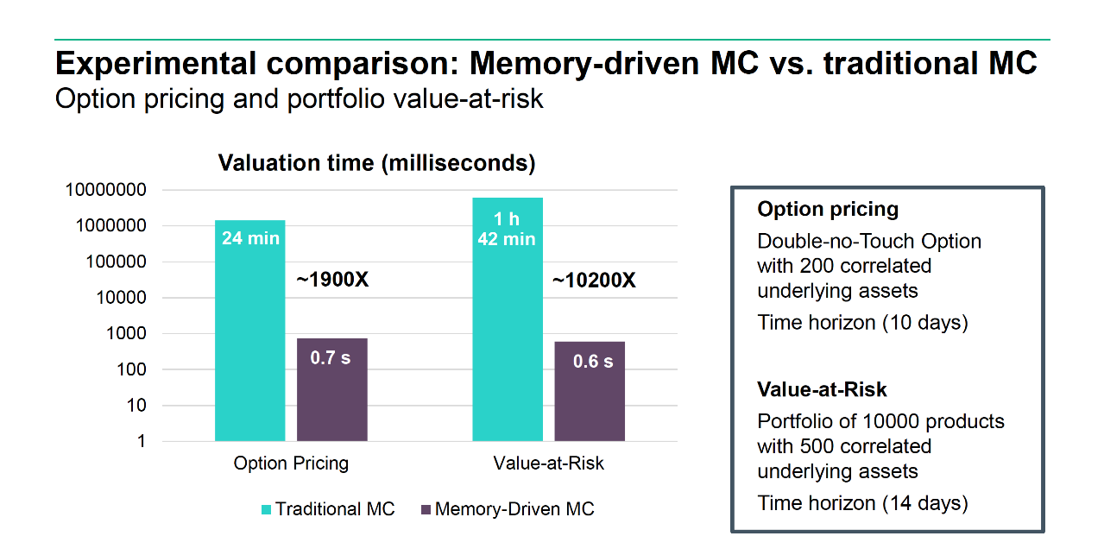
Preliminary Results –HPE Confidential - NDA Required

Slide 30
What’s Next

Slide 31
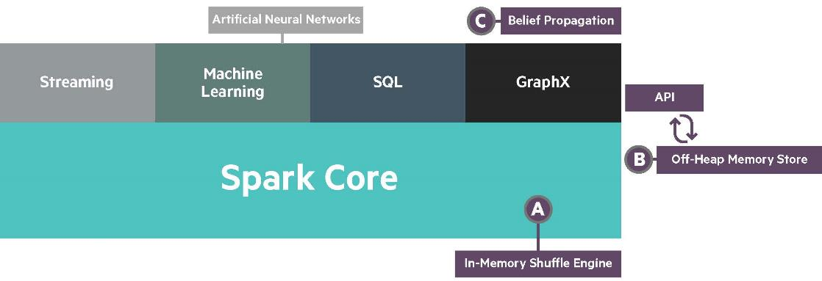
Spark on Memory-Driven Compute Platforms Maximize advantages of large in-memory processing
HPE Components
Artificial Neural Networks
Spark has changed significantly from version 1.2 (initial ‘Machine’ work) to 2.4 (current version)
https://github.com/HewlettPackard/sparkle
Notes:
Released/to be released with Apache 2.0 license
Already released: the shuffle engine and off-heap store (two weeks ago)
Coming months: belief propagation

Slide 32
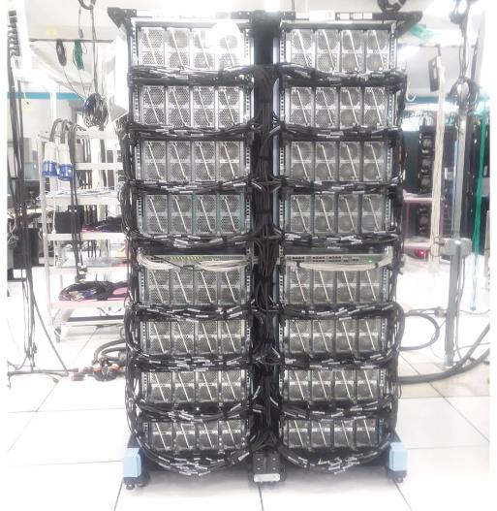
Memory Driven Computing & Superdome Flex
MDC Sandbox
Bridge gap between today and tomorrow
Mainstream POR Activities
Driving beyond POR
Multiple rack solutions
Software-Defined Scalable Memory
Extreme amounts of NVM
Accelerators (e.g. GPUs)
PointNext opportunities
64
Socket
48TB
Current RAM
HPE Confidential - NDA Required

Slide 33
Call to Action
Customers
Use Cases
Partners
Educate

Slide 34
Thank you
www.hpe.com/superdome

Slide 35



Open architecture Customize the hardware to the workload
GPU
FPGA
DSP
ARM
x86
DRAM
Reduced cost
Less energy
Less space
Less complex
NVRAM
RISC V
ASIC
DRAM
SPARC
Photonic
POWER
Neuro
Quantum
Notes:
Here’s how we’re going to free memory from compute and reignite innovation in computing.
You can have memory modules of many types from many sources
I can remove the compute and replace or repair it.
I can switch between high performance or low power compute, or even between architectures.
I can throw one core or a million at a problem. DSPs, FPGAs, GPGPUs, ARM, x86, whatever.
With an open interface
It supports virtually any type or processor you can think of
We’re going to replace virtualization on general purpose µprocessors with task-specific silicon.
Customize the hardware to the workload to dramatically change the cost/power curve.
- general purpose processors, GPUs, DSPs, neuromorphic accelerators…
As you can see, we have Neuromorphic and Photonics as a workload which is part of our longer term research at Labs
[Next: Neuromorphic and optical computing accelerators]

Slide 36





Power critical apps, accelerate data analytics, tackle HPC & AI workloads holistically
HPE Superdome Flex Use Cases
In-memory HPC
In-memory AI
Notes:
Here are the main use cases for Superdome Flex
SAP HANA
Includes multiple use cases
SAP SoH, S/4HANA
SAP BWoH, BW/4HANA
Appliance or TDI
On-prem and in the Hybrid Cloud
Also, HPE IT runs on SAP, this is a great proof point of our experience in this workload
And we are #1 in scale-up and scale-out capacity, plus we have market leadership: >27K servers deployed and we co-innovate with SAP
Oracle
For Oracle customers wanting to
Reduce licensing costs: Superdome Flex can help increase performance per core, which turns into licensing saving
Consolidate workloads to simplify their database landscape
Exadata replacement: for customers who want to simplify their scale out Exadata environment and move to a simpler to manage, more cost efficient scale up deployment with Superdome Flex
Unix migrations: customers who want to lower licensing and operational cost but maintain Unix-like availability can benefit from Superdome Flex
Mix OLTP and analytics: Superdome Flex compute and memory capacity and unique architecture with large scale allows customers to operate both transactional and analytics workloads off of the same data
Our credentials in this space
#1 in scale-up capacity for Oracle DB in-memory
Run on Oracle Linux, OVM
Over 100K Oracle enterprise customers run on HPE
SQL Server
Mission critical SQL Server workloads: for SQL Server customers that need more reliability than they get today with other standard x86 servers, Superdome Flex is a great choice
Scale-up SQL Server: for customers who want to simplify their scale out SQL Server environment and move to a simpler to manage, more cost efficient scale up deployment with Superdome Flex
SQL Server 2008 upgrade opportunities
SQL Server on Linux: relatively new for Microsoft SQL Server customers, ability to run on Linux
And for in-memory analytics on SQL Server
Our credentials in this space
Co-engineering with Microsoft
Broadest SQL Server solutions
Over 29K joint partners
In memory HPC workloads including
Genomics
Computer-aided engineering
Graph analytics
Cyber security
Financial risk management
Fraud prevention
Large data visualization
We deliver
Unparalled scale with single system simplicty
Combines best of SGI and HPE innovation
Deep workload expertise
In memory Artificial Intelligence
Training with strong data interdependency
Inference at speed of memory
Streaming analytics
Couple with up to 16 NVIDIA GPUs for multi workloads
Credentials
HPE Pointnext Services
HPE GreenLake solutions
HPE BlueData AI and Big Data infrastructure software
[Next: Why Superdome Flex for SAP HANA]

Slide 37
Power critical apps, accelerate data analytics, tackle HPC & AI workloads holistically
HPE Superdome Flex Use Cases
In-memory HPC
In-memory AI
SAP SoH, S/4HANA
SAP BWoH, BW/4HANA
Appliance or TDI
On-prem and in the Hybrid Cloud
HPE IT runs on SAP
#1 in scale-up and scale-out capacity
HPE market leadership: >27K servers deployed
HPE/SAP co-innovation
Notes:
Here are the main use cases for Superdome Flex
SAP HANA
Includes multiple use cases
SAP SoH, S/4HANA
SAP BWoH, BW/4HANA
Appliance or TDI
On-prem and in the Hybrid Cloud
Also, HPE IT runs on SAP, this is a great proof point of our experience in this workload
And we are #1 in scale-up and scale-out capacity, plus we have market leadership: >27K servers deployed and we co-innovate with SAP
Oracle
For Oracle customers wanting to
Reduce licensing costs: Superdome Flex can help increase performance per core, which turns into licensing saving
Consolidate workloads to simplify their database landscape
Exadata replacement: for customers who want to simplify their scale out Exadata environment and move to a simpler to manage, more cost efficient scale up deployment with Superdome Flex
Unix migrations: customers who want to lower licensing and operational cost but maintain Unix-like availability can benefit from Superdome Flex
Mix OLTP and analytics: Superdome Flex compute and memory capacity and unique architecture with large scale allows customers to operate both transactional and analytics workloads off of the same data
Our credentials in this space
#1 in scale-up capacity for Oracle DB in-memory
Run on Oracle Linux, OVM
Over 100K Oracle enterprise customers run on HPE
SQL Server
Mission critical SQL Server workloads: for SQL Server customers that need more reliability than they get today with other standard x86 servers, Superdome Flex is a great choice
Scale-up SQL Server: for customers who want to simplify their scale out SQL Server environment and move to a simpler to manage, more cost efficient scale up deployment with Superdome Flex
SQL Server 2008 upgrade opportunities
SQL Server on Linux: relatively new for Microsoft SQL Server customers, ability to run on Linux
And for in-memory analytics on SQL Server
Our credentials in this space
Co-engineering with Microsoft
Broadest SQL Server solutions
Over 29K joint partners
In memory HPC workloads including
Genomics
Computer-aided engineering
Graph analytics
Cyber security
Financial risk management
Fraud prevention
Large data visualization
We deliver
Unparalled scale with single system simplicty
Combines best of SGI and HPE innovation
Deep workload expertise
In memory Artificial Intelligence
Training with strong data interdependency
Inference at speed of memory
Streaming analytics
Couple with up to 16 NVIDIA GPUs for multi workloads
Credentials
HPE Pointnext Services
HPE GreenLake solutions
HPE BlueData AI and Big Data infrastructure software
[Next: Why Superdome Flex for SAP HANA]

Slide 38
Power critical apps, accelerate data analytics, tackle HPC & AI workloads holistically
HPE Superdome Flex Use Cases
In-memory HPC
In-memory AI
Increase performance/core (and reduce licensing costs)
Consolidate workloads
Exadata replacement
Unix migrations
Mix OLTP and analytics
#1 in scale-up capacity for Oracle DB in-memory
Run on Oracle Linux, OVM
Over 100K Oracle enterprise customers run on HPE
Notes:
Here are the main use cases for Superdome Flex
SAP HANA
Includes multiple use cases
SAP SoH, S/4HANA
SAP BWoH, BW/4HANA
Appliance or TDI
On-prem and in the Hybrid Cloud
Also, HPE IT runs on SAP, this is a great proof point of our experience in this workload
And we are #1 in scale-up and scale-out capacity, plus we have market leadership: >27K servers deployed and we co-innovate with SAP
Oracle
For Oracle customers wanting to
Reduce licensing costs: Superdome Flex can help increase performance per core, which turns into licensing saving
Consolidate workloads to simplify their database landscape
Exadata replacement: for customers who want to simplify their scale out Exadata environment and move to a simpler to manage, more cost efficient scale up deployment with Superdome Flex
Unix migrations: customers who want to lower licensing and operational cost but maintain Unix-like availability can benefit from Superdome Flex
Mix OLTP and analytics: Superdome Flex compute and memory capacity and unique architecture with large scale allows customers to operate both transactional and analytics workloads off of the same data
Our credentials in this space
#1 in scale-up capacity for Oracle DB in-memory
Run on Oracle Linux, OVM
Over 100K Oracle enterprise customers run on HPE
SQL Server
Mission critical SQL Server workloads: for SQL Server customers that need more reliability than they get today with other standard x86 servers, Superdome Flex is a great choice
Scale-up SQL Server: for customers who want to simplify their scale out SQL Server environment and move to a simpler to manage, more cost efficient scale up deployment with Superdome Flex
SQL Server 2008 upgrade opportunities
SQL Server on Linux: relatively new for Microsoft SQL Server customers, ability to run on Linux
And for in-memory analytics on SQL Server
Our credentials in this space
Co-engineering with Microsoft
Broadest SQL Server solutions
Over 29K joint partners
In memory HPC workloads including
Genomics
Computer-aided engineering
Graph analytics
Cyber security
Financial risk management
Fraud prevention
Large data visualization
We deliver
Unparalled scale with single system simplicty
Combines best of SGI and HPE innovation
Deep workload expertise
In memory Artificial Intelligence
Training with strong data interdependency
Inference at speed of memory
Streaming analytics
Couple with up to 16 NVIDIA GPUs for multi workloads
Credentials
HPE Pointnext Services
HPE GreenLake solutions
HPE BlueData AI and Big Data infrastructure software
[Next: Why Superdome Flex for SAP HANA]

Slide 39
Power critical apps, accelerate data analytics, tackle HPC & AI workloads holistically
HPE Superdome Flex Use Cases
In-memory HPC
In-memory AI
Run mission critical workloads on SQL Server
Scale up SQL Server
SQL Server 2008 upgrade
SQL Server on Linux
In-memory analytics
Co-engineering with Microsoft
Broadest SQL Server solutions
Over 29K joint partners
Notes:
Here are the main use cases for Superdome Flex
SAP HANA
Includes multiple use cases
SAP SoH, S/4HANA
SAP BWoH, BW/4HANA
Appliance or TDI
On-prem and in the Hybrid Cloud
Also, HPE IT runs on SAP, this is a great proof point of our experience in this workload
And we are #1 in scale-up and scale-out capacity, plus we have market leadership: >27K servers deployed and we co-innovate with SAP
Oracle
For Oracle customers wanting to
Reduce licensing costs: Superdome Flex can help increase performance per core, which turns into licensing saving
Consolidate workloads to simplify their database landscape
Exadata replacement: for customers who want to simplify their scale out Exadata environment and move to a simpler to manage, more cost efficient scale up deployment with Superdome Flex
Unix migrations: customers who want to lower licensing and operational cost but maintain Unix-like availability can benefit from Superdome Flex
Mix OLTP and analytics: Superdome Flex compute and memory capacity and unique architecture with large scale allows customers to operate both transactional and analytics workloads off of the same data
Our credentials in this space
#1 in scale-up capacity for Oracle DB in-memory
Run on Oracle Linux, OVM
Over 100K Oracle enterprise customers run on HPE
SQL Server
Mission critical SQL Server workloads: for SQL Server customers that need more reliability than they get today with other standard x86 servers, Superdome Flex is a great choice
Scale-up SQL Server: for customers who want to simplify their scale out SQL Server environment and move to a simpler to manage, more cost efficient scale up deployment with Superdome Flex
SQL Server 2008 upgrade opportunities
SQL Server on Linux: relatively new for Microsoft SQL Server customers, ability to run on Linux
And for in-memory analytics on SQL Server
Our credentials in this space
Co-engineering with Microsoft
Broadest SQL Server solutions
Over 29K joint partners
In memory HPC workloads including
Genomics
Computer-aided engineering
Graph analytics
Cyber security
Financial risk management
Fraud prevention
Large data visualization
We deliver
Unparalled scale with single system simplicty
Combines best of SGI and HPE innovation
Deep workload expertise
In memory Artificial Intelligence
Training with strong data interdependency
Inference at speed of memory
Streaming analytics
Couple with up to 16 NVIDIA GPUs for multi workloads
Credentials
HPE Pointnext Services
HPE GreenLake solutions
HPE BlueData AI and Big Data infrastructure software
[Next: Why Superdome Flex for SAP HANA]

Slide 40
Power critical apps, accelerate data analytics, tackle HPC & AI workloads holistically
HPE Superdome Flex Use Cases
In-memory HPC
In-memory AI
Genomics
Computer-aided engineering
Graph analytics
Cyber security
Financial risk management
Fraud prevention
Large data visualization
Unparalled scale with single system simplicty
Combines best of SGI and HPE innovation
Deep workload expertise
Notes:
Here are the main use cases for Superdome Flex
SAP HANA
Includes multiple use cases
SAP SoH, S/4HANA
SAP BWoH, BW/4HANA
Appliance or TDI
On-prem and in the Hybrid Cloud
Also, HPE IT runs on SAP, this is a great proof point of our experience in this workload
And we are #1 in scale-up and scale-out capacity, plus we have market leadership: >27K servers deployed and we co-innovate with SAP
Oracle
For Oracle customers wanting to
Reduce licensing costs: Superdome Flex can help increase performance per core, which turns into licensing saving
Consolidate workloads to simplify their database landscape
Exadata replacement: for customers who want to simplify their scale out Exadata environment and move to a simpler to manage, more cost efficient scale up deployment with Superdome Flex
Unix migrations: customers who want to lower licensing and operational cost but maintain Unix-like availability can benefit from Superdome Flex
Mix OLTP and analytics: Superdome Flex compute and memory capacity and unique architecture with large scale allows customers to operate both transactional and analytics workloads off of the same data
Our credentials in this space
#1 in scale-up capacity for Oracle DB in-memory
Run on Oracle Linux, OVM
Over 100K Oracle enterprise customers run on HPE
SQL Server
Mission critical SQL Server workloads: for SQL Server customers that need more reliability than they get today with other standard x86 servers, Superdome Flex is a great choice
Scale-up SQL Server: for customers who want to simplify their scale out SQL Server environment and move to a simpler to manage, more cost efficient scale up deployment with Superdome Flex
SQL Server 2008 upgrade opportunities
SQL Server on Linux: relatively new for Microsoft SQL Server customers, ability to run on Linux
And for in-memory analytics on SQL Server
Our credentials in this space
Co-engineering with Microsoft
Broadest SQL Server solutions
Over 29K joint partners
In memory HPC workloads including
Genomics
Computer-aided engineering
Graph analytics
Cyber security
Financial risk management
Fraud prevention
Large data visualization
We deliver
Unparalled scale with single system simplicty
Combines best of SGI and HPE innovation
Deep workload expertise
In memory Artificial Intelligence
Training with strong data interdependency
Inference at speed of memory
Streaming analytics
Couple with up to 16 NVIDIA GPUs for multi workloads
Credentials
HPE Pointnext Services
HPE GreenLake solutions
HPE BlueData AI and Big Data infrastructure software
[Next: Why Superdome Flex for SAP HANA]

Slide 41
Power critical apps, accelerate data analytics, tackle HPC & AI workloads holistically
HPE Superdome Flex Use Cases
In-memory HPC
In-memory AI
Training with strong data interdependency
Inference at speed of memory
Streaming analytics
Couple with up to 16 NVIDIA GPUs for multi workloads
HPE Pointnext Services
HPE GreenLake solutions
HPE BlueData AI and Big Data infrastructure software
Notes:
Here are the main use cases for Superdome Flex
SAP HANA
Includes multiple use cases
SAP SoH, S/4HANA
SAP BWoH, BW/4HANA
Appliance or TDI
On-prem and in the Hybrid Cloud
Also, HPE IT runs on SAP, this is a great proof point of our experience in this workload
And we are #1 in scale-up and scale-out capacity, plus we have market leadership: >27K servers deployed and we co-innovate with SAP
Oracle
For Oracle customers wanting to
Reduce licensing costs: Superdome Flex can help increase performance per core, which turns into licensing saving
Consolidate workloads to simplify their database landscape
Exadata replacement: for customers who want to simplify their scale out Exadata environment and move to a simpler to manage, more cost efficient scale up deployment with Superdome Flex
Unix migrations: customers who want to lower licensing and operational cost but maintain Unix-like availability can benefit from Superdome Flex
Mix OLTP and analytics: Superdome Flex compute and memory capacity and unique architecture with large scale allows customers to operate both transactional and analytics workloads off of the same data
Our credentials in this space
#1 in scale-up capacity for Oracle DB in-memory
Run on Oracle Linux, OVM
Over 100K Oracle enterprise customers run on HPE
SQL Server
Mission critical SQL Server workloads: for SQL Server customers that need more reliability than they get today with other standard x86 servers, Superdome Flex is a great choice
Scale-up SQL Server: for customers who want to simplify their scale out SQL Server environment and move to a simpler to manage, more cost efficient scale up deployment with Superdome Flex
SQL Server 2008 upgrade opportunities
SQL Server on Linux: relatively new for Microsoft SQL Server customers, ability to run on Linux
And for in-memory analytics on SQL Server
Our credentials in this space
Co-engineering with Microsoft
Broadest SQL Server solutions
Over 29K joint partners
In memory HPC workloads including
Genomics
Computer-aided engineering
Graph analytics
Cyber security
Financial risk management
Fraud prevention
Large data visualization
We deliver
Unparalled scale with single system simplicty
Combines best of SGI and HPE innovation
Deep workload expertise
In memory Artificial Intelligence
Training with strong data interdependency
Inference at speed of memory
Streaming analytics
Couple with up to 16 NVIDIA GPUs for multi workloads
Credentials
HPE Pointnext Services
HPE GreenLake solutions
HPE BlueData AI and Big Data infrastructure software
[Next: Why Superdome Flex for SAP HANA]

Slide 42

If you thought you were having trouble keeping up today, it’s only going to get worse
175 ZB
DATA
But conventional compute improving only incrementally
Growing capability gap
Massive advances in computing power needed everywhere
Exponentially-increasing data
Exploding data sources
Shrinking time to action
X
X
=
130 ZB
100 ZB
63 ZB
33 ZB
25 ZB
COMPUTE
15 ZB
1.8 ZB
9.0 ZB
0.3 ZB
1.0 ZB
3.0 ZB
DATA
COMPUTE
2005
2010
2015
2020
2025
Notes:
Every two years, we’re creating more data than through all of history. We’re experiencing an exponential increase in data, coming from an explosion of sources and we have a vanishingly small time to turn that data into meaningful action. With transistor scaling slowing or stopped (depending on who you ask) the gap between what we desire to accomplish and what we can accomplish is widening. Our ambitions are growing faster than our computers can improve.
We also have a sustainability problem. Today, IT infrastructure consumes over 10% of global energy production. And that production can only grow slowly. So we have an energy gap too. Unless we do something radical.
Clearly, we need a new kind of computer.
The next slide looks deeper at the numbers behind the capability gap.
[next: more on the compute gap]
Data: IDC Data Age 2025 study, sponsored by Seagate, Nov 2018 https://www.seagate.com/files/www-content/our-story/trends/files/idc-seagate-dataage-whitepaper.pdf
Compute curve: HPE analysis, summarizing K. Rupp. 42 Years of Microprocessor Trend Data karlrupp.net/2018/02/42-years-of-microprocessor-trend-data

Slide 43
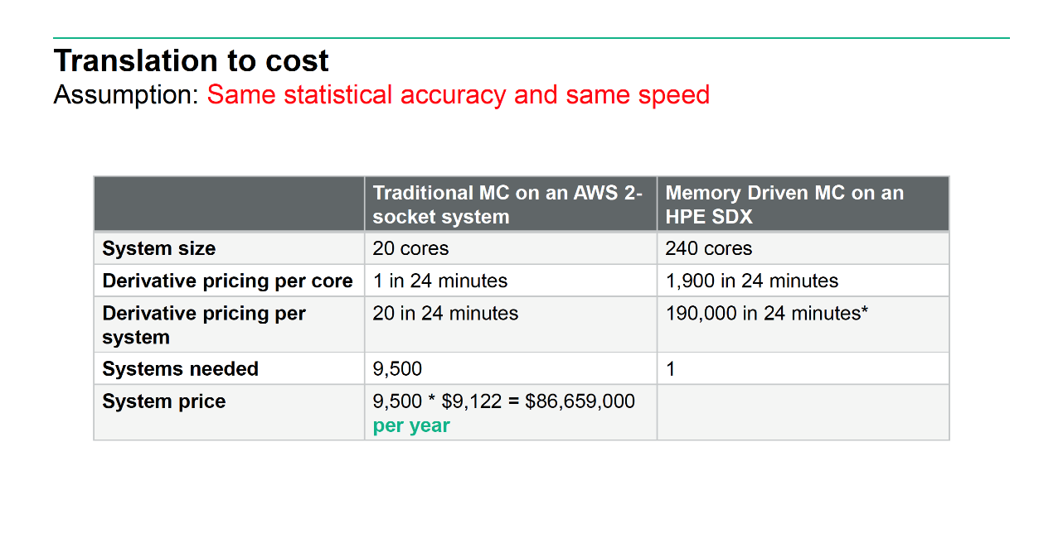
Preliminary Results –HPE Confidential - NDA Required

Slide 44
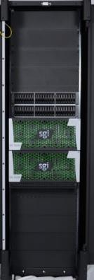
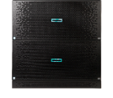
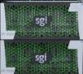

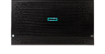
Potential to Compose Superdome Flex Systems with Software-Defined Scalable Memory
SDSM
With Intel 2nd Generation Xeon Scalable Processor family and Optane DC Persistent Memory DIMMs:
12TB persistent SDSM per chassis, 96TB per rack
Dynamically assigned to compute partitions
SDSM chassis become the most powerful intelligent storage elements in HPE portfolio
FAM
SDSM
SDSM
SDSM
4-skt CPU
SSI
4-skt CPU
SSI
4-skt CPU
SSI
4-skt CPU
SSI
4-skt CPU
SSI
16-skt
CPU
SSI
4-skt CPU
SSI
8-skt CPU
SSI
HPE Confidential - NDA Required

Slide 45
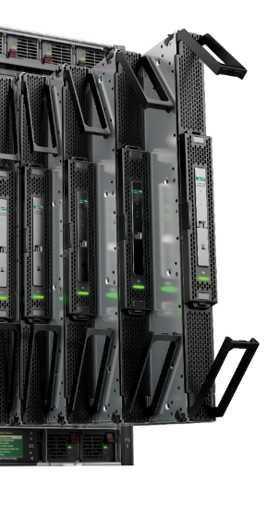

Real-time insights on massive datasets
Supercharging Spark with Superdome X (from 2015)
Dataset 1
101 million nodes
1.7 billion edges
Dataset 2
1.7 billion nodes
11.4 billion edges
300 sec
201 sec
15X
faster
Not possible
13 sec
Spark
Spark for
The Machine
Spark
Spark for
The Machine
Notes:
Spark is one of the leading open source tools to do in-memory analytics on a cluster of servers.
As part of another project, we wanted to see what we could do with Spark if we adapted to a large memory system. The results were astounding. So much so that we decided to take that work and make it available to you now!
With our enhancements to Spark – all being contributed back to the open source community - We can not only deliver 15X better performance on Superdome X, but we can do it on data sets that are not possible on conventional Spark clusters.
Show the online demo of Spark for The Machine/MDC - https://sirius-3.labs.hpe.com:8443/SparkDemo/
We chose a real-world hyperlink graph – the URLs and Web links from a crawled copy of the Internet in 2012 (over 1.75 billion URLS & 100 million sites)– and a known list of white-listed (benign) black-listed (malicious) websites. In this demo, we run an integrative graph inferencing algorithm to determine if an unknown website was malicious or benign.
Graph Inferencing (iterations 1-8)
Now that the graph is loaded into memory, we begin inferencing on the data – this is an iterative process. During each iteration, messages are sent between every node (URL) that is connected to another node via an edge (hyperlink). In each iteration, a node is assigned a probability of maliciousness. You’ll notice the speed-up that our modified Spark achieves, typically between 10-16X faster than unmodified Spark depending on how much time is spent “inferencing” or shuffling data during that iteration.
The dots are colored according to maliciousness level (intensity of orange is reflection of more malicious). The links over on the right column so the 200 most malicious sites ranked during that iteration. Probabilities change during each iteration, so the dots will change color and the rank order will change as well.
Final iteration 9, after about 7-10 iterations, the probabilities will converge. All 101 Million sites are now assigned their most accurate probability of maliciousness. (tap view summary to see results)
Results Screen, this inferencing process took just over 2 minutes. On unmodified Spark, the same process would’ve taken about a half hour. By taking a memory-driven approach to solving this problem, we can bring predictive analytics tasks such as graph inferencing to near real-time speeds.
[note: workload is an iterative graph benchmark]
This is what the chart is showing – not just incredible performance, but tackling problems you couldn’t solve otherwise
But, what if we could take that even further?
Mention the partnership with Hortonworks
SAN FRANCISCO, Calif., —On March 1, 2016 Hortonworks, Inc. ® and Hewlett Packard Labs, announced a collaboration to enhance Apache Spark, one of the most active Apache big data projects. The collaboration will center around an entirely new class of analytic workloads that benefit from large pools of shared memory.
Early results of the collaboration include the following:
Enhanced shuffle engine technologies: Faster sorting and in-memory computations, which has the potential to dramatically improve Spark performance.
Better memory utilization: Improved performance and usage for broader scalability, which will help enable new large-scale use cases.
[Next: Larges Scale Graph Inference demo]

Slide 46
Memory-Driven Computing has the power to transform industries
Modify existing frameworks
New algorithms
Completely rethink
In-memory analytics
Genome
comparison
Large-scale graph inference
Financial models
15x faster
100x faster
1000x faster
10,000x faster
Notes:
This is what you can achieve if you throw away 60 years of software assumptions and legacy.
Spark is one of the leading open source tools to do in-memory analytics on a cluster of servers.
As part of another project, we wanted to see what we could do with Spark if we adapted to a large memory system. The results were astounding.
15X s compared to “vanilla” Spark. We can also run 20x bigger data sets that won’t run all at all normally. All from rewriting a couple of hundred lines of code.
[harnesses the “well-connected” vector. Not big memory, just many processing elements on the pool of memory]
[The other three harnesses abundance: need all the memory the same “distance” away]
As world populations age, the human and economic toll of currently incurable neurodegenerative diseases such as Alzheimer’s grows staggering. DZNE fights these diseases using Big Data analytics, but the limitations of traditional computer systems have been a major bottleneck. Seeking a breakthrough solution, DZNE discovered HPE’s Memory-Driven Computing—and saw unprecedented computational speed improvements that hold new promise in the race against Alzheimer’s.
Using Memory-Driven Computing programming techniques on an HPE Superdome X system, DZNE has seen a 22 minute process drop to 13 seconds. That’s more than a 100x speed improvement
Graphs increasingly represent our connected world today. Graph inference is how you make predictions using a small known set of data.
Comparison is with GraphLab, the state-of-the-art today.
Financial modelling is Monte Carlo simulations used to predict things like derivatives pricing and portfolio risk management.
Comparison is with open source QuantLib package.
If you plan sharing the Memory-Driving Computing SW proof point section, you can talk more about how we’ve come up with these numbers.

Slide 47
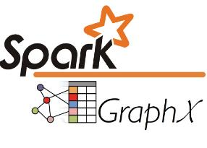

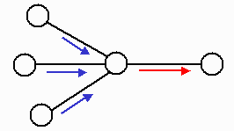
Spark Benchmarks
Not possible with traditional approach
3.7x
8-15x

